Slide 1
Object-Oriented Software Engineering
Practical Software Development using UML and Java
Chapter 3:
Basing Software Development on
Reusable Technology
Part 2

Slide 2
3.4 The Client-Server Architecture
Software architecture is the branch of software engineering that deals with how to organize and connect a set of software modules so that they can work together with each other.
one of the most widely used is the client–server architecture.
A distributed system is a system in which:
  computations are performed by separate programs.
  … normally running on separate pieces of hardware.
  … that co-operate to perform the task of the system as a whole.
Chap. 3: Basing Development on Reusable Technology

Slide 3
3.4 The Client-Server Architecture
Server:
  A program that provides a service for other programs that connect to it using a communication channel.
Client
  A program that accesses a server (or several servers) to obtain services.
  A server may be accessed by many clients simultaneously.
A client–server system is a distributed system involving at least one server and one client.
Chap. 3: Basing Development on Reusable Technology

Slide 4
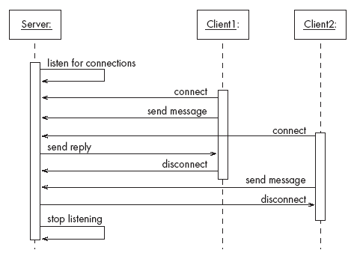
A server program communicating with two client programs
The vertical lines represent the three programs involved.
After connecting, Client 1 sends a message, receives a reply and disconnects.
Client 2 connects while Client 1 is still connected; it simply sends a message and then disconnects.
This diagram is an example of a UML sequence diagram
Chap. 3: Basing Development on Reusable Technology

Slide 5
Sequence of activities in a client-server system
  In general, the components of a client–server system interact as follows:
  The server starts running
  The server waits for clients to connect. (listening)
  Clients start running and perform operations
    Some operations involve requests to the server
  When a client attempts to connect, the server accepts the connection (if it is willing)
  The server waits for messages to arrive from connected clients
  When a message from a client arrives, the server takes some action in response, then resumes waiting
  Clients and servers continue functioning in this manner until they decide to shut down or disconnect.
Chap. 3: Basing Development on Reusable Technology

Slide 6
Sequence of activities in a client-server system
  Normally, the action taken by the server includes sending a message back to the client.
  Most servers have to be able to handle connections from many clients and respond to messages from all the connected clients.
  It is possible for the same program to be both a client and a server at the same time. For example, a database server might connect to another server in order to obtain additional data.
Chap. 3: Basing Development on Reusable Technology

Slide 7
Advantages of client-server systems
  The computational work can be distributed among different machines.
    some computations on the server and distribute others to the clients.
    If everything is done on the server, then a powerful computer may be needed. On the other hand, if the clients take care of some computations then the server’s workload will be lighter.
  The clients can access the server’s functionality from a distance
  The client and server can be designed separately
    The development work can be done by independent groups
  All the data can be kept centrally at the server
    making it easier to assure its reliability. For example, it can be easier to ensure that regular backups are made of a single server’s data.
Chap. 3: Basing Development on Reusable Technology

Slide 8
Advantages of client-server systems
  Conversely, data can be distributed among many different geographically-distributed clients or servers.
    if a disaster occurs in one place, the loss of data is minimized.
  The server can be accessed simultaneously by many clients.
  Competing clients can be written to communicate with the same server, and vice-versa
    different web browsers can communicate with the same web server.
Chap. 3: Basing Development on Reusable Technology

Slide 9
Example of client-server systems
  The World Wide Web
  Email
  Transaction Processing System
  Communication System
  Database System
Chap. 3: Basing Development on Reusable Technology

Slide 10
Exercise:
If you were designing a server for the following class of application, list the kinds of main activities that you might expect the server to do:
(a) A server for an airline reservation system.
Chap. 3: Basing Development on Reusable Technology

Slide 11
Solution
An airline reservation server would be expected to do some of the following activities:
    • Maintain the list of flights along with basic details of each flight (and allow changes)
    • Maintain the prices (and allow changes, special offers etc.)
    • Maintain the bookings (allow bookings to be made, changed and deleted)
    • Allow people to query all of the above
Chap. 3: Basing Development on Reusable Technology

Slide 12
Activities of a server: Capabilities that must be provided when designing a server
The server must initialize itself so that it is able to provide the required service. For example, a server that handles airline reservations might load data describing the available flights.
It must start listening for clients attempting to connect. Until it starts listening, any client that attempts to connect will not succeed.
Handles the following types of events originating from clients
  accepts connections from client.
  responds to messages
  handles disconnection of client.
May stop listening
Must cleanly terminate i.e. shut down, when necessary
Chap. 3: Basing Development on Reusable Technology

Slide 13
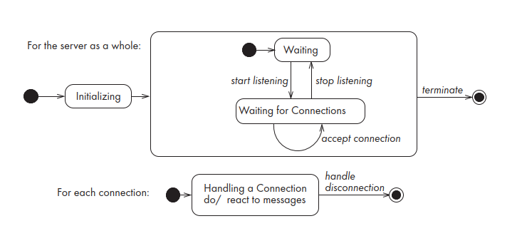
Activities of a server
Chap. 3: Basing Development on Reusable Technology

Slide 14
Activities of a client
Initializes itself so that it is able to communicate with the server. For example, it needs to know the network address of the server.
Initiates a connection
Sends messages
Handles the following types of events originating from the server
  responds to messages
  handles server disconnection
Must cleanly terminate
Chap. 3: Basing Development on Reusable Technology

Slide 15
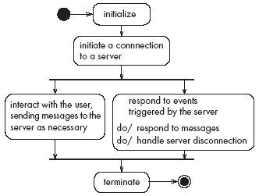
Activities of a client
Chap. 3: Basing Development on Reusable Technology

Slide 16
Concurrency in client–server systems
Client–server systems are inherently concurrent because the server runs at the same time as the clients, normally (but not necessarily) on different computers.
The client will normally be doing the following things concurrently:
    Waiting for interactions with the end-user, and responding when interactions occur.
    Waiting for messages coming from the server, and responding when messages arrive.
Chap. 3: Basing Development on Reusable Technology

Slide 17
Concurrency in client–server systems
The server should normally have concurrent threads which do the following:
      Waiting for interactions with the user who is in charge of the server, and responding as necessary.
    Waiting for clients to try to connect and establishing connections as needed.
    For each connected client, waiting for messages coming from that client, and responding when messages arrive.
    Servers thus normally operate with at least two concurrent threads, and in general n+2 threads where n is the number of connected clients.
Chap. 3: Basing Development on Reusable Technology

Slide 18
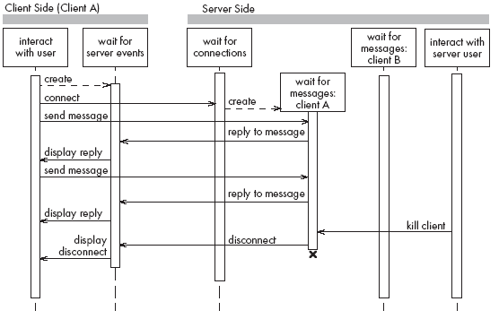
Threads in a client-server system
Chap. 3: Basing Development on Reusable Technology

Slide 19
Thin- versus fat-client systems
The work of a client–server system can be distributed in several different ways.
Thin-client system (a)
  Client is made as small as possible
  Most of the work is done in the server.
  It is easy to download the client program over the network and to launch it.
Fat-client system (b)
  As much work as possible is delegated to the clients.
  The server can therefore be smaller or can be made to handle more clients.
Chap. 3: Basing Development on Reusable Technology

Slide 20
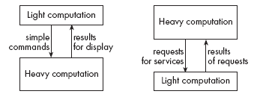
Thin- versus fat-client systems
(a)
(b)
Chap. 3: Basing Development on Reusable Technology

